Slide 1
eCos Real-Time Operating System

Slide 2
The eCos is an open source tool to create embedded kernels and applications

Slide 3
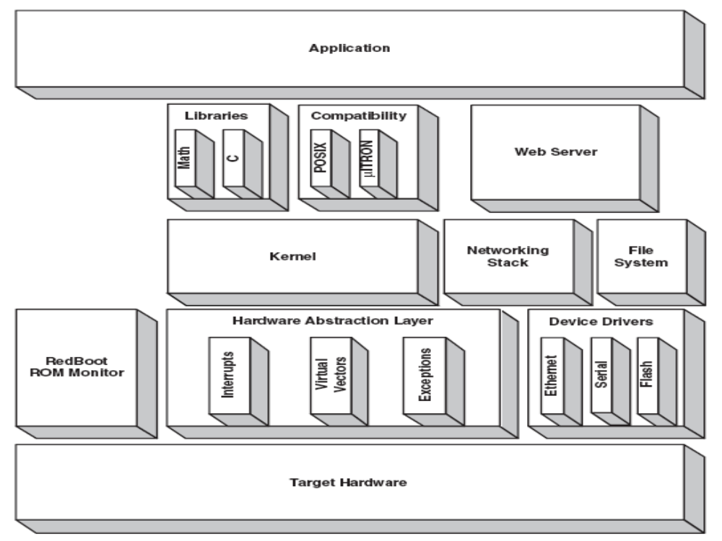
Layering of eCos system packages

Slide 4
Configuration System
It is the ‘heart’ of eCos.
Select only the packages that are necessary through configuration.
This reduces the footprint of the application.
eCos uses compile-time control methods.
This allows the application writer control over individual lines of code in the packages.
The control methods are implemented through C Preprocessor

Slide 5
eCos Components
The following are the core components :
  Hardware Abstraction Layer
  Real-time kernel.
  ISO C and math libraries
  Device drivers
  GNU Debugger (GDB) support
The real-time kernel is the central core component.

Slide 6
eCos API
eCos supports the following standard API
  µitron
  POSIX
  Embedded Linux API compatible with EL/IX.
  It’s own native API.

Slide 7
Hardware Abstraction Layer (HAL)
The HAL is a software layer.
It provides a platform independent API for platform specific functionality.
Enhances portability of code.

Slide 8
Features of eCos RTOS
1. Configurability: eCos is highly configurable, which means that developers can select only the components they need for their specific application. This helps to reduce the size and complexity of the operating system, which is especially important in resource constrained embedded systems.
2. Multitasking: eCos is a multitasking operating system, which means it can run multiple tasks or threads simultaneously. This is essential for real-time systems, where multiple processes must be executed concurrently to ensure timely and reliable operation.
3. Memory Management: eCos provides advanced memory management features, including support for virtual memory, memory protection, and dynamic memory allocation. These features help to ensure the reliability and security of the operating system and the applications running on it.

Slide 9
4. Hardware Abstraction: eCos provides a hardware abstraction layer (HAL) that allows developers to write device drivers and other low-level code that is independent of the underlying hardware. This makes it easier to port eCos to new hardware platforms and reduces the amount of code that must be rewritten for each new device.
5. Real-Time Performance: eCos is designed to be a real-time operating system, which means that it is optimized for applications that require precise timing and responsiveness. It provides features such as interrupt handling, task scheduling, and priority-based preemption to ensure that real-time deadlines are met.
6. Scalability: eCos is designed to be scalable, which means that it can be used in a wide range of embedded systems, from small, single-process systems to large, complex systems with multiple processors and multiple tasks running in parallel.
7. Open Source: eCos is released under an open-source license, which means that developers can download and modify the source code to meet their specific needs. This has led to a large community of developers contributing to the project and creating new features and applications based on eCos.

Slide 10
Working Principle of eCos RTOS
1. Initialization: When an embedded system is powered on, the eCos kernel is loaded into memory and initializes the system hardware, such as setting up interrupt controllers and initializing device drivers.
2. Thread Scheduling: eCos provides a priority-based thread scheduler that ensures that high-priority threads are executed before lower-priority threads. Each thread is assigned a priority, and the scheduler selects the highest-priority thread that is ready to run.
3. Interrupt Handling: When an interrupt occurs, the eCos interrupt handler is invoked. The handler saves the state of the current thread and switches to the interrupt service routine (ISR) for the corresponding interrupt. When the ISR is finished, the interrupt handler restores the state of the previous thread and returns to the thread scheduler.

Slide 11
4. Memory Management: eCos provides memory management services, including virtual memory support, memory protection, and dynamic memory allocation. Memory pools are used to allocate memory to threads, which reduces the risk of memory fragmentation.
5. Device Drivers: eCos provides a device driver framework that allows developers to write device drivers for specific hardware platforms. Device drivers communicate with the hardware through the HAL (Hardware Abstraction Layer), which provides a standardized interface to the hardware.
6. Interprocess Communication: eCos provides interprocess communication (IPC) mechanisms that allow processes to communicate with each other quickly and efficiently. IPC is based on message passing and supports synchronous and asynchronous messaging, shared memory, and remote procedure calls (RPCs).
7. Configuration: eCos is highly configurable, and developers can select only the components they need for their specific application. The eCos Configuration Tool (ECT) provides a graphical interface that simplifies the configuration process and generates the necessary source code and make files.

Slide 12
Supported Hardware Platforms by eCos RTOS
1. ARM: eCos supports a variety of ARM processors, including Cortex-M, Cortex-R, and Cortex-A series.
2. Intel x86: eCos supports the Intel x86 architecture, including the Intel Atom and Pentium processors.
3. MIPS: eCos supports the MIPS architecture, including the MIPS32 and MIPS64 processors.
4. PowerPC: eCos supports the PowerPC architecture, including the PowerPC 400 and PowerPC 500 series processors.
5. Renesas: eCos supports a variety of Renesas processors, including the Renesas RZ/A1, RZ/A2, and RZ/G1 series.
6. Texas Instruments: eCos supports a variety of Texas Instruments processors, including the Sitara AM335x and AM437x series.
7. Atmel AVR32: eCos supports the Atmel AVR32 architecture, including the AVR32 AP7000 and UC3 series processors.
8. Microchip PIC32: eCos supports the Microchip PIC32 architecture, including the PIC32MX and PIC32MZ series processors.
9. Freescale ColdFire: eCos supports the Freescale ColdFire architecture, including the ColdFire V1, V2, and V3 series processors.

